Slide 1




Auditing Framework
Auditing framework is critical operating system security infrastructure for intrusion detection, provenance analysis, compliance verification, and attack reconstruction.
SoTA: Sysdig, OMNILOG, Ellipsis, Linux Audit.
Ellipsis
Notes:
Auditing framework is critical operating system security infrastructure for intrusion detection, provenance analysis, compliance verification, and attack reconstruction.
There are multiple Auditing frameworks adopted in industry and academy such as Sysdig, OMNILOG, Ellipsis and Linux Audit.

Slide 2
Popular Auditing Frameworks
Notes:
This figure shows several representative architectures of different system auditing frameworks, including Sysdig, Linux Auditd, OMNILOG and NODROP. Where Sysdig and Linux Auditd are commonly used commercial products and OMNILOG and NODROP are academia researches.
The typical auditing framework, take Sysdig for example, employs a classic asynchronous auditing architecture: a kernel module intercepts syscall events and stores them in a kernel buffer, while an independent user-space daemon asynchronously reads and processes them.

Slide 3
Security Threats on Auditing Frameworks
Flood Attack
Race Condition Attack
Race Condition Attack: An attack can delete audit events generated by malicious processes from the kernel buffers before they have been submitted to the consumer.
Flood Attack: An attacker can quickly generate a large number of invalid system logs, crowd the log buffer, and cause the subsequent attack log loss. (Also taken as PDoS attack)
Notes:
Attackers have noticed the value of audit events and try to compromise this system auditing to conceal their malicious activities.
There are two common attacks —— race condition attack and flood attack.
The first on is race condition attack: An attack can delete audit events generated by malicious processes from the kernel buffers before they have been submitted to the consumer (based on the observation that the events will reside in the buffer for more than 10ms).
The second on is flood attack: An attacker can quickly generate a large number of invalid system logs, crowd the log buffer, and cause the subsequent attack log loss. (Also taken as PDoS attack)

Slide 4
Existing Auditing Frameworks
Weakness Overview
Sysdig, Linux Auditd, Ellipsis:
Unbounded event residence time
Event dropping
Priority inversion
OMNILOG:
Substantial execution overhead
syscall overhead,
virtualization overhead.
NODROP:
Large consumer interference
Burst event processing
Long time residence time.
Notes:
Sysdig, Linux Auditd and Ellipsis faces both race condition attack and flood attack. They employ an asynchronous, single-consumer architecture that processes audit events from all tasks in user space, ,leading to potential priority inversion and event loss under heavy loads.
OMNILOG and NODROP focus on addressing race condition attack and flood attack respectively. However, they also have weaknesses.
OMNILOG adopts a synchronous, hypervisor-based architecture where each syscall triggers an immediate hypercall to transfer events into a secure buffer, ensuring near-zero residence time but introducing high virtualization overhead.
NODROP introduces a per-thread consumer model where each thread's events are handled by a dedicated, lightweight threadlet within its own address space, preventing event loss but allowing unbounded residence time due to batch processing and increased consumer interference

Slide 5
Existing Auditing Frameworks
Weakness
It’s essential for creating a safe, predictable and efficient Auditing Framework to guarantee Real-Time performance.
Sysdig & Ellipsis:
Priority inversion,
Unbounded event residence time,
Event dropping, queuing delays.
OMNILOG:
Substantial execution overhead a) syscall overhead,
b) virtualization overhead.
NODROP:
Large consumer interference,
Burst event processing,
Long time residence time.
Notes:
Therefore, for Real-time system, it’s essential for creating a safe, predictable and efficient Auditing Framework to guarantee Real-Time application performance.

Slide 6
Research Goals
An auditing framework for real-time systems needs to match these following goals.
Event integrity
Guaranteed schedulability
Bounded event residence time
Minimized overhead
Notes:
Our goal in creating the real-time auditing framework includes:
Event integrity: all audit events must be collected and processed on time without loss.
Bounded event residence time: the duration of events that reside in the insecure kernel buffer should be bounded.
Furthermore, administrators can flexibly control the duration depending on task criticality or sensitivity.
Guaranteed schedulability: the execution and interference of the auditing framework should be bounded and can be adapted to response time analysis to evaluate system schedulability.
and minimized overhead: the auditing framework should not occupy too many system resources that significantly slow down the whole system even under high-frequency event generation in multi-core environments.

Slide 7
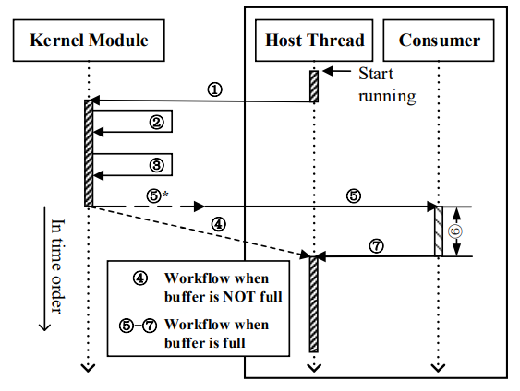
Real-Time Auditing Implementation
S1: The kernel captures a system call (①) and executes it (②). System call is recored in a dedicated in-kernel logging buffer (③).
S2: Buffer is not full: returns control to the host thread (④). Buffer is full or the thread exits: control is passed to the consumer (⑤).
S3: Consumer is instrumented into the running thread(⑤∗).
S4: Consumer process the transferred provenance data (⑥).
S5: Control is returned to the original thread (⑦).
NODROP Workflow
Peng Jiang, Ruizhe Huang, Ding Li, Yao Guo, Xiangqun Chen, Jianhai Luan, Yuxin Ren, and Xinwei Hu. 2023. Auditing frameworks need resource isolation: a systematic study on the super producer threat to system auditing and its mitigation. In Proceedings of the 32nd USENIX Conference on Security Symposium (SEC '23). USENIX Association, USA, Article 21, 355–372.
Notes:
To match the above goals, we introduce a real-time system auditing framework, RT-NODROP, that is predictable, secure, and efficient.
RT-NODROP is a variant of NODROP designed to provide efficient consumer execution and guarantee event integrity.
Here is the workflow of NODROP.
Nodrop has five stages.
S1: The kernel captures a system call (①) and executes it (②). The kernel module then catches and records the system call in a dedicated in-kernel logging buffer (③).
S2: We check the status of the buffer. Buffer is not full: returns control to the host thread (④). Buffer is full or the thread exits: control is passed to the consumer (⑤).
S3: If the consumer is not in the memory of running thread. It instruments the consumer into the current running thread(⑤∗) only in the first time.
S4: Consumer uses the running thread’s resource quota to process the transferred provenance data (⑥).
S5: When processing is complete, control is returned to the original thread (⑦).

Slide 8
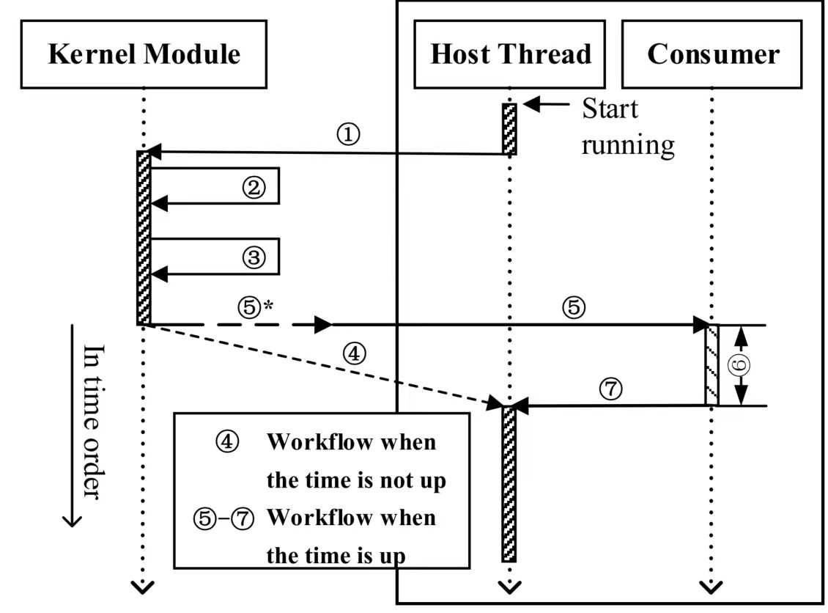
Real-Time Auditing Implementation
I
Periodic consumer invocation.
Bounded consumer WCET.
Bounded event residence time.
Bounded kernel buffer memory usage.
RT-NODROP Workflow
Notes:
Concretely, RT-NODROP introduces the following optimizations to improve NODROP.
First of all, Periodic consumer invocation:
NODROP does not invoke the consumer until the buffer is full, leading to burst execution and extremely long event residence time.
In contrast, RT-NODROP periodically invokes the consumer to ensure schedulability.

Slide 9
Real-Time Auditing Implementation
II
Task-aware event residence time control.
Individually controlled based on load and interference between applications.
Customize constraints and goals for event residence time.
RT-NODROP Workflow
Notes:
Second, Task-aware event residence time control:
We implement two optimizations to balance event residence time, schedulability, and system efficiency.
On the one hand, the consumer invocation period of each application is individually controlled based on its load and interference between applications.
This enables each task to have a different and controlled event residence time.
On the other hand, system administrators can customize constraints and goals for event residence time.
This flexibility allows administrators to prioritize, for instance, minimizing the event residence time for the highest-priority task or optimizing the average event residence time across all tasks.

Slide 10
Real-Time Auditing Implementation
III
Decoupling consumer invocation from syscall execution.
Uses a per-thread timer to asynchronously invoke a consumer.
Workflow
Notes:
Third, Decoupling consumer invocation from syscall execution:
This approach reduces the latency of syscall-intensive applications, such as Redis.
In detail, for each thread, RT-NODROP registers a timer during the consumer initialization and sets its expiration time as the calculated consumer invocation period.
The timer binds a callback function to prepare the consumer execution context for that thread.
When the timer is triggered, the kernel executes the callback function, which replaces the program counter with the consumer entry point, initializes other registers, and allocates a stack for the consumer.

Slide 11
Real-Time Auditing Implementation
IV
Consumer pre-loading.
Consumers are loaded in advance at the time of each thread creation.
Only has the cost of switching to the consumer, without the cost of loading and initialization.
Workflow
Notes:
Finally, Consumer pre-loading:
This approach means that consumers are loaded in advance at the time of each thread creation.
In the subsequent thread execution, RT-NODROP only has the cost of switching to the consumer, without the cost of loading and initialization.

Slide 12
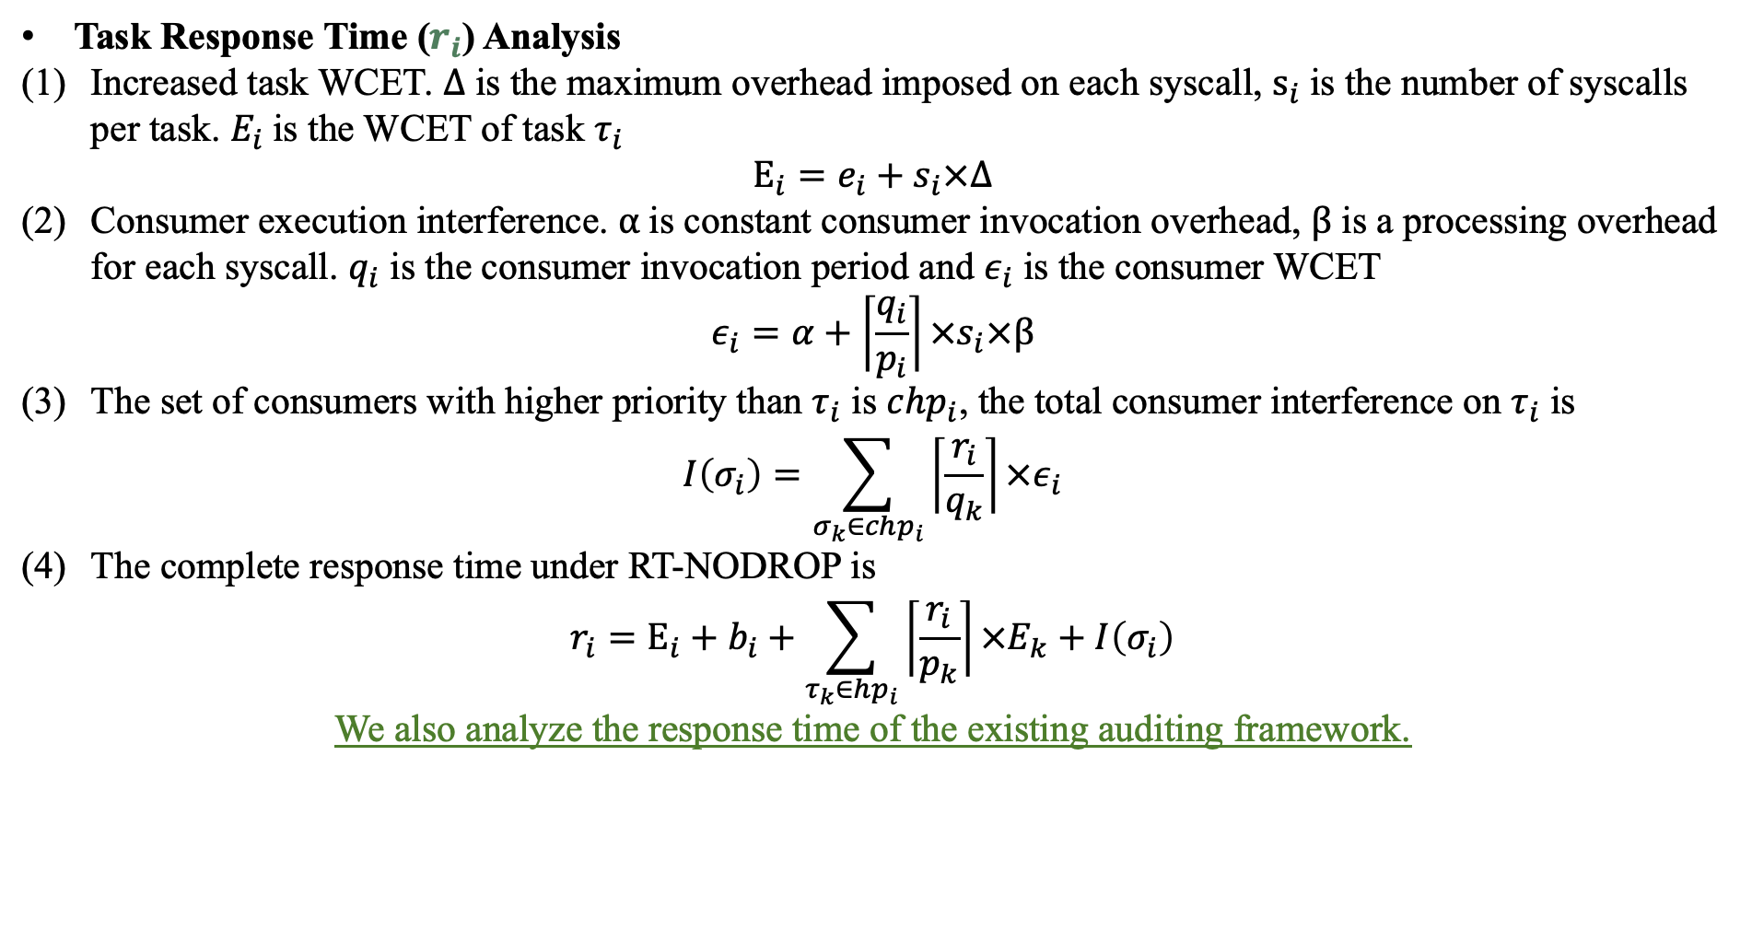
Response Time and Residence Time Analysis
Task Response Time ($r_{i}$) Analysis
Increased task WCET. $Δ$ is the maximum overhead imposed on each syscall, $s_{i}$is the number of syscalls per task. $E_{i}$is the WCET of task $τ_{i}$
$$E_{i}=e_{i}+s_{i}×Δ$$
Consumer execution interference. $α$is constant consumer invocation overhead, $β$ is a processing overhead for each syscall. $q_{i}$ is the consumer invocation period and $ε_{i}$ is the consumer WCET
$$ε_{i}=α+\left\lceil \frac{q_{i}}{p_{i}}\right\rceil ×s_{i}×β$$
The set of consumers with higher priority than $τ_{i}$ is $chp_{i}$, the total consumer interference on $τ_{i}$ is
$$I\left(σ_{i}\right)=\sum_{σ_{k}∈chp_{i}}{\left\lceil \frac{r_{i}}{q_{k}}\right\rceil ×ε_{i}}$$
The complete response time under RT-NODROP is
$$r_{i}=E_{i}+b_{i}+\sum_{τ_{k}∈hp_{i}}{\left\lceil \frac{r_{i}}{p_{k}}\right\rceil }×E_{k}+I\left(σ_{i}\right)$$
We also analyze the response time of the existing auditing framework.
Notes:
We provide detailed mathematical derivation, including task response time analysis and event residence time analysis, to support our design.
This task response time analysis is based on “Applying New Scheduling Theory to Static Priority Pre-emptive Scheduling” presented by N. Audsley.
Specifically , Task response time analysis quantifies two auditing overheads—the first is syscall tracing and the second is consumer execution—and incorporates it into a real-time task model.
It provides a formula to finally compute worst-case response times.

Slide 13
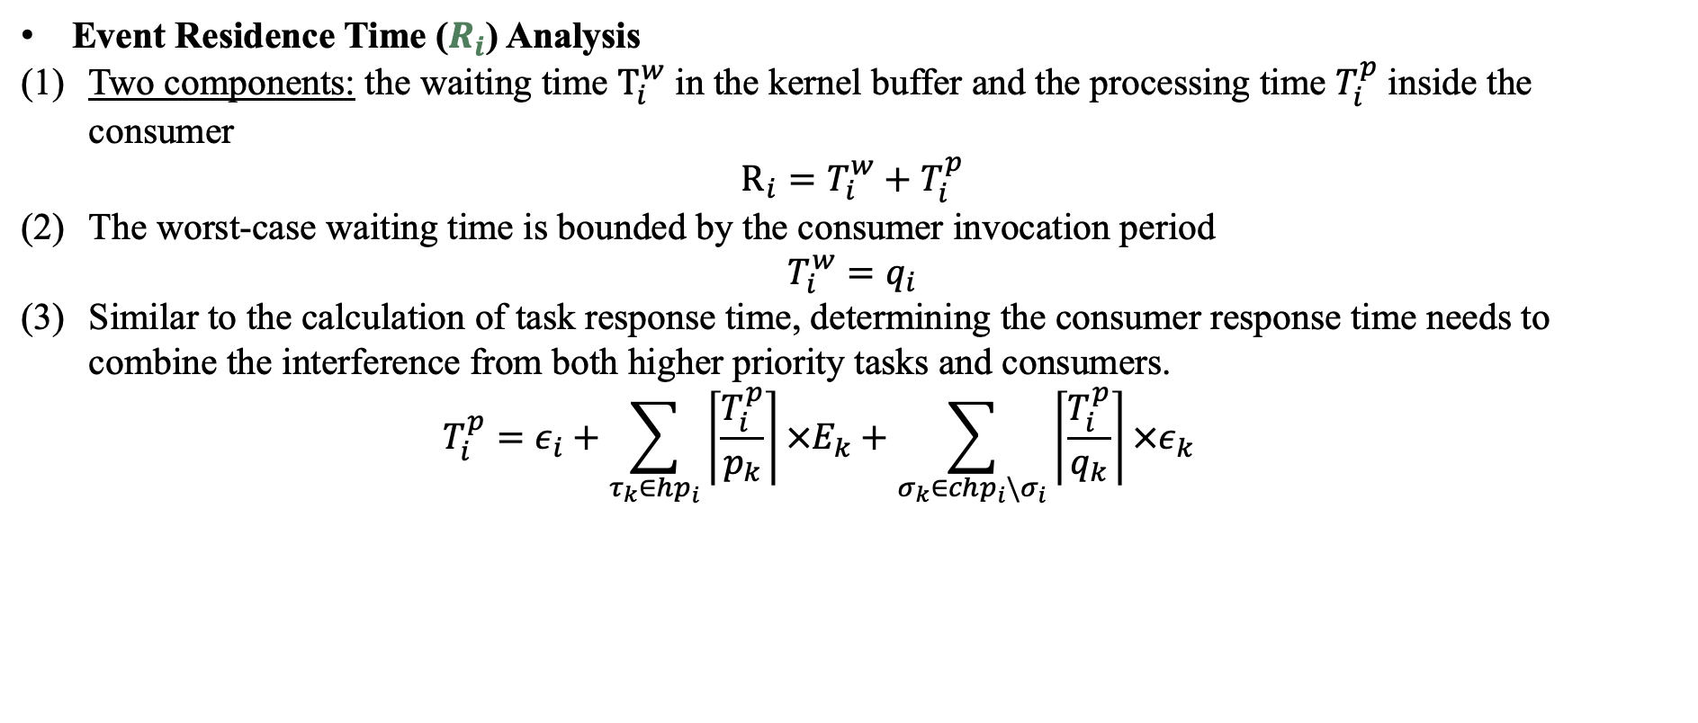
Response Time and Residence Time Analysis
Event Residence Time ($R_{i}$) Analysis
Two components: the waiting time $T_{i}^{w}$ in the kernel buffer and the processing time $T_{i}^{p}$ inside the consumer
$$R_{i}=T_{i}^{w}+T_{i}^{p}$$
The worst-case waiting time is bounded by the consumer invocation period
$$T_{i}^{w}=q_{i}$$
Similar to the calculation of task response time, determining the consumer response time needs to combine the interference from both higher priority tasks and consumers.
  $$T_{i}^{p}=ε_{i}+\sum_{τ_{k}∈hp_{i}}{\left\lceil \frac{T_{i}^{p}}{p_{k}}\right\rceil }×E_{k}+\sum_{σ_{k}∈chp_{i}\backslash σ_{i}}{\left\lceil \frac{T_{i}^{p}}{q_{k}}\right\rceil }×ε_{k}$$
Notes:
Here, event residence time analysis is broken into waiting and processing phases, with bounds derived from consumer periods and response times. This ensures predictable and secure event handling, mitigating race-condition and flooding attacks.

Slide 14
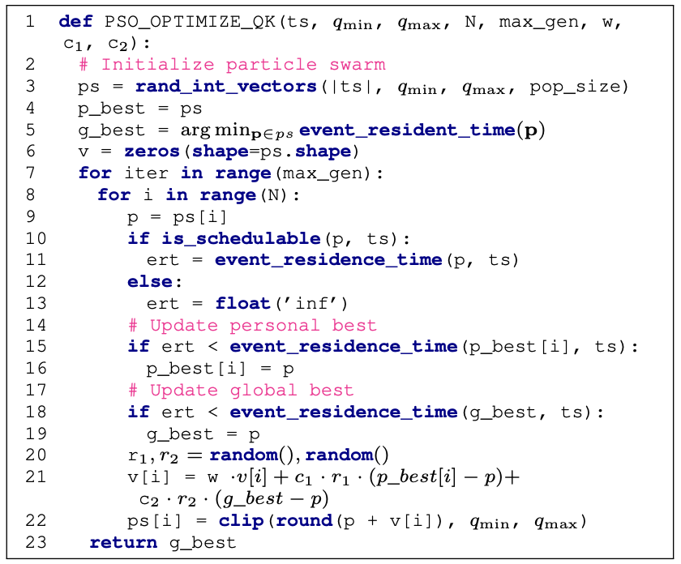
Response Time and Residence Time Analysis
Consumer Period Selection
Use PSO algorithm to adjust the consumer invocation period of each task.
Optimize the event residence time while ensuring the system schedulability.
Notes:
We use PSO algorithm to adjust the consumer invocation period of each task.
This PSO-based algorithm optimizes consumer invocation periods to jointly satisfy schedulability and event residence time constraints. This allows administrators to balance security, performance, and real-time guarantees.

Slide 15
Evaluation 1: Micro Benchmark
Syscall performance: The impact of RT-NODROP on syscalls is smaller than that of Sysdig and OMNILOG. The performance of RT-NODROP is up to 4 times higher than that of Ellipsis.
 | stat | read | write | Open/close | null
Sysdig | 1.85 | 1.10 | 1.00 | 3.69 | 0.86
Sysdig-dropfree | 2.86 | 2.45 | 2.28 | 6.01 | 2.00
OMNILOG | 3.80 | 3.28 | 3.19 | 7.80 | 3.06
Auditd | 9.21 | 5.65 | 5.32 | 18.55 | 4.75
Ellipsis | 7.37 | 4.52 | 4.26 | 14.84 | 3.80
NODROP | 1.45 | 0.95 | 0.89 | 2.88 | 0.68
RT-NODROP | 1.61 | 1.07 | 1.00 | 3.16 | 0.76
TABLE: lmbench results in microsecond. Smaller is better.
Notes:
Our evaluation consists of three parts.
The first part is micro benchmark.
we use lmbench to measure the syscall overhead caused by different auditing frameworks and list the results in the Table.
We found that the impact of RT-NODROP on syscalls is smaller than that of Sysdig and OMNILOG. For example, the execution time of OMNILOG for all syscalls is up to 1.5 times higher than that of RT-NODROP.
The syscall overhead of RT-NODROP is slightly higher than that of NODROP. We conclude that this additional cost comes from the higher frequency of consumer invocation.

Slide 16
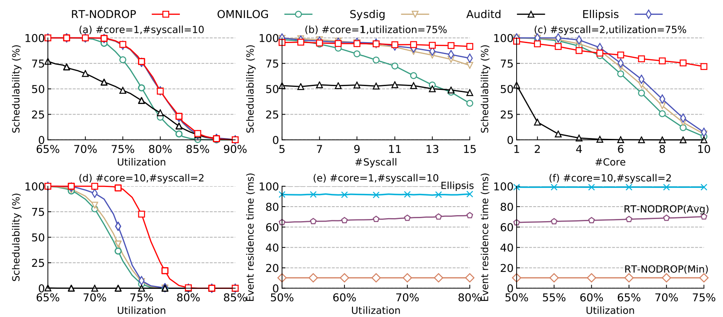
Evaluation 2: Schedulability and Event Residence Time
Schedulability: RT-NODROP is superior over SOTA frameworks.
Event residence time: Remains stable, consistently around 10ms.
Figure: Response time and event residence time analysis.
On average, RT-NODROP outperforms Sysdig (OMNILOG) by 11.63% (21.98%) and outperforms Ellipsis (Auditd) by 8.64% (850.97%).
 | fig. 4(a) | fig. 4(b) | fig. 4(c) | fig. 4(d)
Sysdig | 0.67% | 3.24% | 24.15% | 18.45%
OMNILOG | 8.85% | 26.24% | 32.38% | 20.54%
Auditd | 32.30% | 80.00% | 1342.85% | 1948.73%
Ellipsis | 0.35% | 1.71% | 18.82% | 13.67%
TABLE: SUA improvement
Notes:
Our second evaluation measures the schedulability and event residence time of different frameworks, and measures the improvement in the Schedulable Utilization Areas (SUAs).
We found that the schedulability of RT-NODROP is superior over SOTA frameworks and its event residence time remains stable, consistently around 10ms.
On average, RT-NODROP outperforms Sysdig (OMNILOG) by 11.63% (21.98%) and outperforms Ellipsis (Auditd) by 8.64% (850.97%).

Slide 17
Evaluation 3: Real-world Application (Redis)
RT-NODROP achieves up to 75.1% (138.86%, 324.6%) higher throughput and 2.19× (3.07×, 5.02x) lower 99.9th percentile tail latency than Sysdig (OMNILOG, Ellipsis).
RT-NODROP maintains a minimum event residence time around 10ms without event dropping.
Figure: Redis performance on single core under different auditing frameworks
Notes:
Finally, we use Redis as a representative to illustrate how RT-NODROP provides lower tail latency for latency-sensitive applications while maintaining the same throughput with NODROP.
We found that RT-NODROP achieves up to 75.1% (138.86%, 324.6%) higher throughput and 2.19× (3.07×, 5.02x) lower 99.9th percentile tail latency than Sysdig (OMNILOG, Ellipsis).
RT-NODROP maintains a minimum event residence time around 10ms without event dropping.

Slide 18
Evaluation 3: Real-world Application (Redis)
NODROP & RT-NODROP shows a similar distribution on both single-core and multi-core.
Sysdig and OMNILOG have worse distribution and longer tail latency, Auditd and Ellipsis are even worse.
Figure: The cumulative distribution function of Redis set/get latency under different auditing frameworks.
Notes:
This figure shows the distribution of the set/get latency.
NODROP and RT-NODROP shows a similar distribution on both single-core and multi-core, but NODROP has a much longer tail.
Sysdig and OMNILOG has worse overall distribution and longer tail latency than NODROP, while Auditd and Ellipsis are even worse, validating the predictability guarantees in RT-NODROP.
Auditd shows the worst results of both set and get. The latency of Ellipsis is more than four times that of RT-NODROP.

Slide 19
Evaluation 3: Real-world Application (Redis)
When the Redis server is running on a single core, 99% of the RT-NODROP’s events reside for less than 20ms in the kernel buffer, which is much smaller than that of Sysdig and NODROP.
Notes:
RT-NODROP always achieves the lowest P99 event residence time.
The CDF result shows that, when the Redis server is running on a single core, 99% of the RT-NODROP’s events reside for less than 20ms in the kernel buffer, which is much smaller than that of Sysdig and NODROP. 97% of NODROP’s events reside in the buffer for more than 500ms.
We conclude that it adopts a huge buffer size and needs to wait a long time for the buffer to reach its capacity and switch to the consumer.
It is worth noting that, when an application generates the system call events at a lower rate, the buffer will be extremely hard to fill, and the event residence time may be even higher.

Slide 20
Conclusion
Existing auditing frameworks fail to meet the predictability and security requirements of real-time systems.
  They lack bounded worst-case execution time (WCET) and cannot integrate with real-time schedulability analysis, leading to unpredictable interference.
  Attackers can exploit race conditions or flood audit buffers to tamper with or drop critical audit events, undermining system security.
We propose RT‑NODROP, which employs a periodic, threadlet-based design and integrates with Response Time Analysis to simultaneously achieve security and real-time guarantees.
RT‑NODROP improves schedulability by up to 117.9% and reduces Redis tail latency by up to 5.02× compared to state‑of‑the‑art frameworks (Sysdig, OMNILOG, Ellipsis).
Notes:
In conclusion, Existing auditing frameworks fail to meet the predictability and security requirements of real-time systems.
On one hand, they lack bounded worst-case execution time (WCET) and cannot integrate with real-time schedulability analysis, leading to unpredictable interference.
On the other hand, attackers can exploit race conditions or flood audit buffers to tamper with or drop critical audit events, undermining system security.
We propose RT‑NODROP, which employs a periodic, threadlet-based design and integrates with Response Time Analysis to simultaneously achieve security and real-time guarantees.
RT‑NODROP improves schedulability by up to 117.9% and reduces Redis tail latency by up to 5.02× compared to state‑of‑the‑art frameworks (Sysdig, OMNILOG, Ellipsis).

